Slide 1
Geog Research preparation

Slide 2
Objectives
Select range of case studies and justify selection
Deconstruct question –define terms eg tectonic event profile/responses of people and governments
Select which concepts/models are relevant and why (include misconceptions) Start to APPLY them
Share success criteria using mark scheme/examiners report

Slide 3
Examiner’s feedback
Models were popular , however, it is significant that many candidates would explain the models, e.g. Dreggs, Parks, but would not then apply it in their discussion of an issue/case study. This was a significant weakness.
There was some lack of rigour in the use of subject specific terminology; indeed some had minimal use at all with linked simple syntax. Higher level terminology is to be encouraged given this is an A2 exam. Go for it- eg Lahar/ pyroclastic flow/ large scale ground displacement-Quake Lakes!!!!!
There was also a general lack of precision in the nomenclature of places; the U.S.A was America, and Africa seemingly considered to be a nation state. Know where- but don’t draw a map !!!!!
Lastly on QWC: writing in the first person ‘In my exam I am goingto talk about…….’is to be discouraged.

Slide 4
Great Case studies-Select with reason
Indian Ocean Tsunamis created by quake 2004-Global scale/ global response UN/DEC -Modify loss Burden-scale/speed of onset-Problems with aid-lessons learnt internationally
Iceland- 2010Glacial melt locally (Jokulhaulp) /Ash over N Europe-Gov response and critisism and bias /Control mitigation strategies by Civil Aviation Authority
Haiti-2010 EQ Shallow, high magnitude, low frequency event near densely pop capital city of highly vulnerable state application of Dregg’s model Why so vulnerable? ( recent bias in news reports/aid messages)
Pinatubo-Volcano-Ash/Laha/ application of Park model also

Slide 5
China- 2008 Wenchuan- EQ- landslides/ massive displacement/lakes created ...flood risk in transition economy-rapid response and questionable government role (bias) Use of new technology (satellite) to respond during secondary impacts. Modifying event? Etna-channelling lava flow
Montserrat- Pyroclastic flows modifying human vulnerability/Tolrance levels of community/evacuation/zoning/ monitoring-Globalisation science community /commonwealth links and migration
USA California EQ’s frequent low magnitude?-Key role of USGS and FEMA-planning regs/retro fitting/design-preparedness –Techno- fix

Slide 6
Tectonic event profile
Plot the profile of selected case studies on a graph so you can compare them at a glance-(relative to each other) and reveal the complex variation of impacts e.g. of Earthquakes
Magnitude
Speed of onset
Duration
Aerial extent
Frequency
Spatial predictability

Slide 7
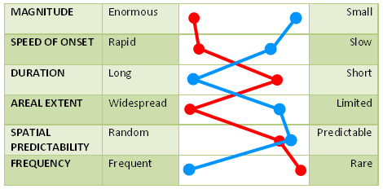
1.2 Event profile of hazards, including frequency, magnitude, duration and areal extent.
Not all tectonic hazards are the same
Event profiles are a common way of comparing different hazards
In this example the 2004 Asian Tsunami and ongoing eruption of Kilauea on Hawaii are compared
Hazard profiles can be drawn for any event.
The nature of the hazard creates the level of challenge
Refer to the event profiles you have drawn for your 6 detailed case studies. Draw event profiles so you can compare and contrast your examples
7

Slide 8
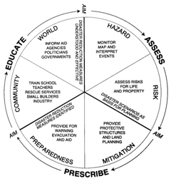
4.1 The varying approaches of individuals and governments to coping with tectonic hazards in countries at different stages of development.
Modify Loss
Move to a safer location
Modify the Event
Modify human Vulnerability
People cope with natural hazards in very different ways
The chosen ways are often related to wealth and access to technology
Humans do have a capacity to ignore or seriously underestimate risk, even when it seems obvious to others
Often it may seem obvious that people should move out of harms way, but in reality this may be impossible.
8

Slide 9
Who are the Key players? Remember to demonstrate understanding of range of Scales
Local communities
Regional bodies/authorities- US state emergency services
National agencies eg USGS/ FEMA
N. G.O.’s
DEC-disasters and emergency committee
Global regions eg Central American scientific community
UN / International scientific bodies

Slide 10
Central Focus?
What contributes to or determines the response decisions made by key players. What, for example is the relative importance of frequency and spatial predictability over magnitude. How important is the signature profile of individual/similar events Do decision makers learn from previous events in different places.

Slide 11
Models
Select and APPLY them-
the easiest way is to redraw them with a case study included e.g Park’s model applied to Pinatubo

Slide 12
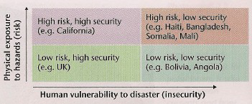
Put your case studies in groups....But is it as simple as MEDC/LEDC?

Slide 13
Apply Dregg’s Model

Slide 14
To Haiti

Slide 15
Like this... Select info from Haiti case study

Slide 16
Secondary impacts analysis-Wenchuan Earthquake 2008.

Slide 17
Risk intolerance threshold... Apply to Montserrat

Slide 18
Select & Collect a range of (accurate) references ...Harvard system
Books
Gates, A.E & Ritchie. D. (2007) Encyclopaedia of Earthquakes and Volcanoes
Waugh 1996-Chapt 1 ( pages....) Mt Pinatubo
AS /A2 text books......
Television/Video
Haiti Earthquake(2010) Channel 4 programme
Montserrat (1998) ..........
Killer Volcanoes (Channel 4 May 2010)
Web sites
USGS www/.......USGS (2010) Updating faultlines in California
FEMA-
UN (2010)Haiti response-learning the lessons from Bandah Aceh –
New York times online
Newspaper
Times-Icelandic Ash brings Chaos to Northern Europe
Gaurdian.........
Academic Journals
Liou, Kar, and Chang, 2009: Use of high-resolution Formosat-2 satellite images for post-earthquake disaster assessment: A study following 12 May 2008 Wenchuan earthquake. Int. J. Remote Sensing, accepted on 14 May 2009.

Slide 19
A grade: Success Criteria
Well focused introduction, clear discussion, definitions linked to title with case study justification
Well selected research: range of case studies and examples used to support argument. Don’t waste time on location maps!!!!!!
Referencing/sourcing should feature throughout the answer
Able to formulate arguments and maintain discussion e.g. using questions through report
Effective conclusion linked back to main body & on-going evaluation within essay-bias and different perspectives/question validity e.g. You tube/Western Eurocentric perspectives
report- shows complexity of the Q
Well written, uses evaluative language and specialist terminology,
May be topical, uses any models and diagrams effectively-not bolted on
May be more essay based this first series than proper report style

Slide 20
PLAN

