Slide 1
Psychology watch list

Slide 2
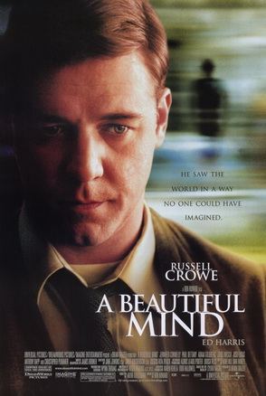
A beautiful mind
Starring: | Russell Crowe
What’s it about? | True story of mathematician John Nash and his struggle with schizophrenia
What topics is it useful for? | Schizophrenia
Age rating: | 12
Realism rating: | *****
Rating: | *****

Slide 3
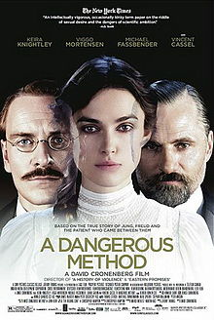
A dangerous method
Starring: | Keira Knightley
What’s it about? | Freud and Jung take their ideas to America but disagree massively in how they view one famous patient
What topics is it useful for? | Approaches in psychology
Age rating: | 15 (lots of sex)
Realism rating: | ****
Rating: | ****

Slide 4
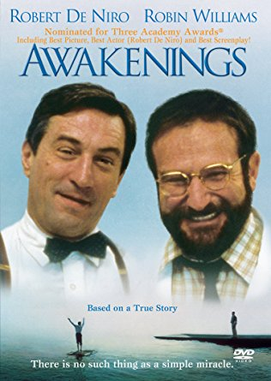
Awakenings
Starring: | Robert de Niro, Robin Williams
What’s it about? | A psychiatrist goes to work with a group of mental health patients whose illness cannot be diagnosed
What topics is it useful for? | Behaviours (year 13)
Age rating: | 12
Realism rating: | *****
Rating: | ***

Slide 5
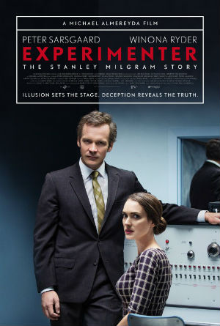
Experimenter
Starring: | Peter Sarsgaard, Winona Ryder
What’s it about? | The life and times of Stanley Milgram and his famous obedience research
What topics is it useful for? | Approaches, Issues and debates, Research Methods
Age rating: | 15
Realism rating: | ****
Rating: | *****

Slide 6
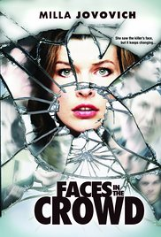
Faces in the crowd
Starring: | Milla Jovovich
What’s it about? | A woman is attacked and loses her ability to recognise faces, which is a problem as she is the only one who can recognise the attacker
What topics is it useful for? | Biological approach
Age rating: | 15
Realism rating: | **
Rating: | **

Slide 7
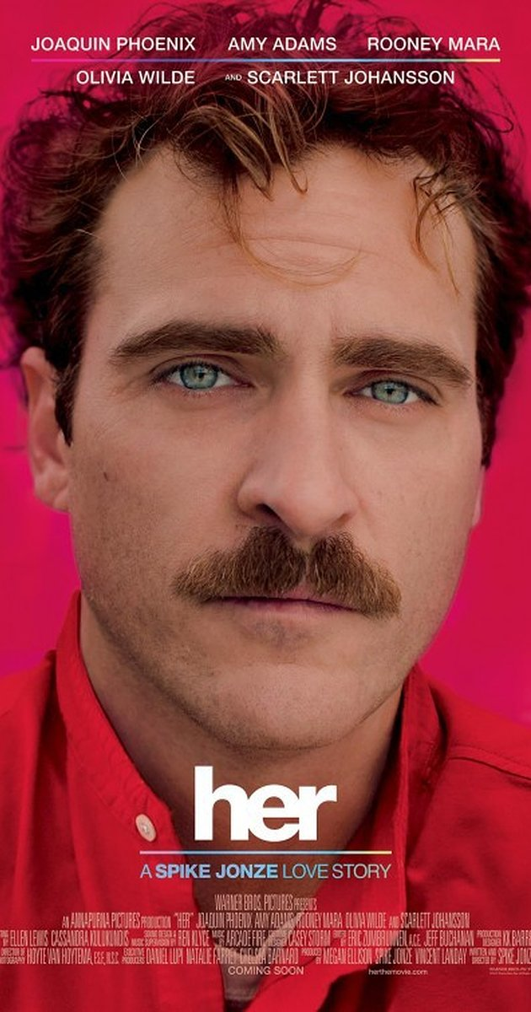
Her
Starring: | Joaquin Phoenix
What’s it about? | A man with a broken heart starts an online relationship
What topics is it useful for? | Relationships
Age rating: | 15
Realism rating: | **
Rating: | *****

Slide 8
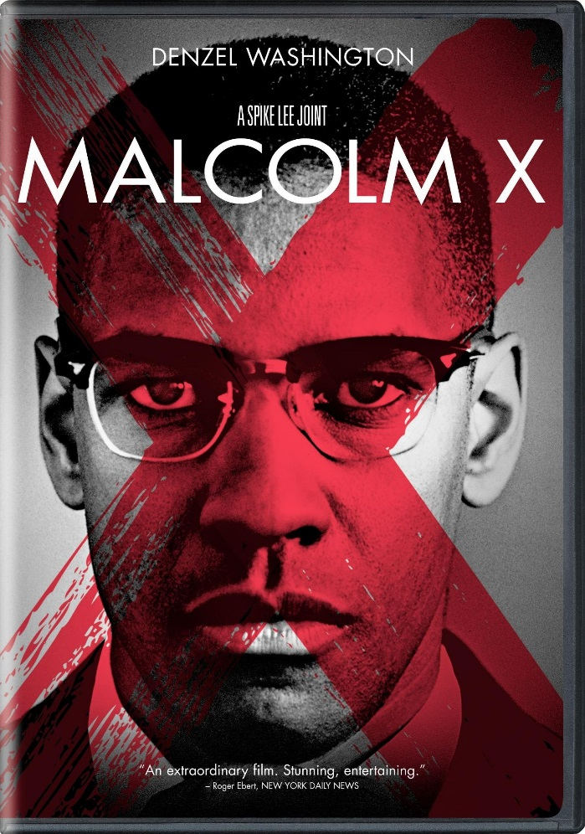
Malcolm X
Starring: | Denzel Washington
What’s it about? | The true story of civil rights campaigner, Malcolm X
What topics is it useful for? | Behaviourist approach
Age rating: | 15
Realism rating: | ****
Rating: | ****

Slide 9
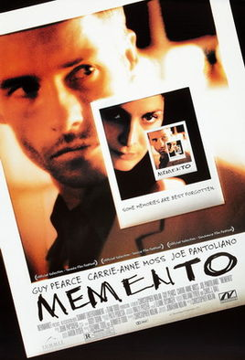
Memento
Starring: | Guy pearce
What’s it about? | A man loses the ability to form new memories but needs to find a way to remember who killed his wife so he can exact revenge
What topics is it useful for? | Cognitive psychology
Age rating: | 15
Realism rating: | ***
Rating: | ****

Slide 10
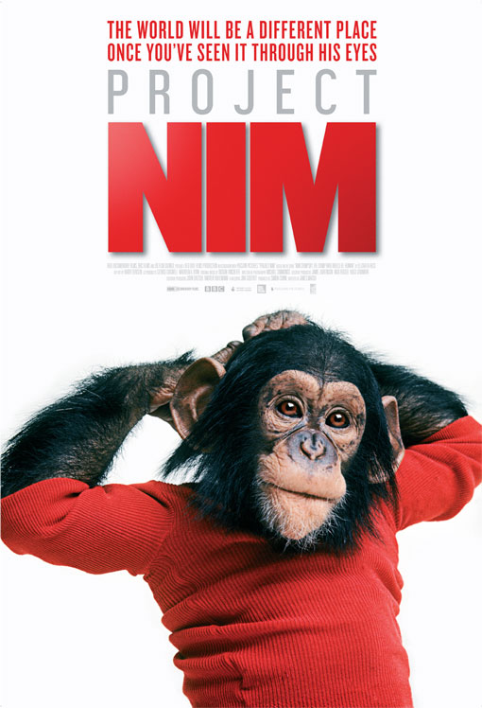
Project Nim
Starring: | Nim Chimpsky
What’s it about? | A chimp is raised as a human and taught sign language
What topics is it useful for? | Issues and debates, behaviourism
Age rating: | 12
Realism rating: | *****
Rating: | *****

Slide 11
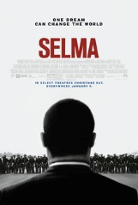
Selma
Starring: | David Oyelowo
What’s it about? | The true story of Martin Luther King’s march from Selma
What topics is it useful for? | Psychology of persuasion
Age rating: | 15
Realism rating: | *****
Rating: | ***

Slide 12
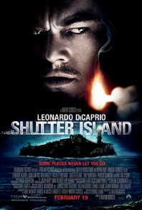
Shutter Island
Starring: | Leonardo di Caprio
What’s it about? | A woman has disappeared from a mental health institution and detectives are sent to investigate
What topics is it useful for? | Schizophrenia
Age rating: | 15
Realism rating: | ***
Rating: | *****

Slide 13
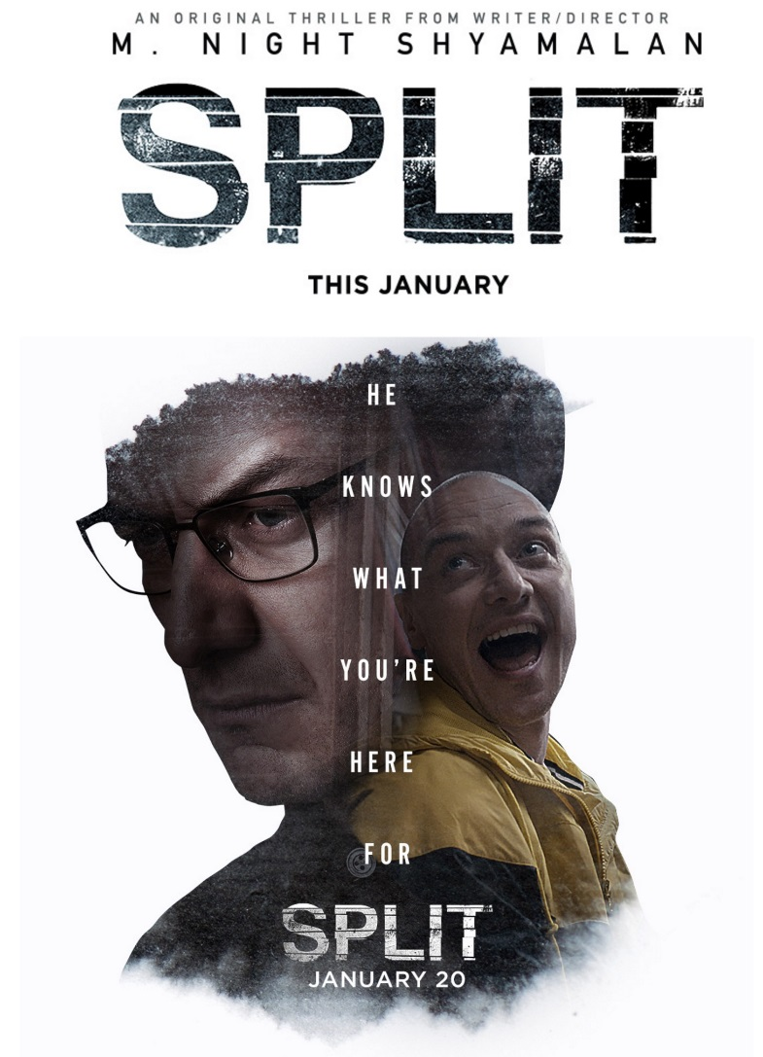
Split
Starring: | James McAvoy
What’s it about? | Girls are kidnapped by a man with multiple personality disorder
What topics is it useful for? | Schizophrenia
Age rating: | 15
Realism rating: | **
Rating: | *****

Slide 14
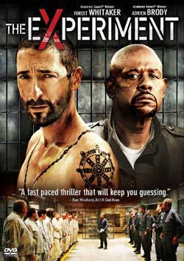
The experiment
Starring: | Adrien Brody, Forest Whitaker
What’s it about? | A Hollywood interpretation of the famous Stanford Prison study
What topics is it useful for? | Research methods (ethics)
Age rating: | 15
Realism rating: | *
Rating: | ***

Slide 15
The men who stare at goats
Starring: | Ewan McGregor, George Clooney
What’s it about? | A journalist researches a military department designed to use mind control in their army
What topics is it useful for? | Behaviours (year 13)
Age rating: | 15
Realism rating: | *****
Rating: | ****

Slide 16
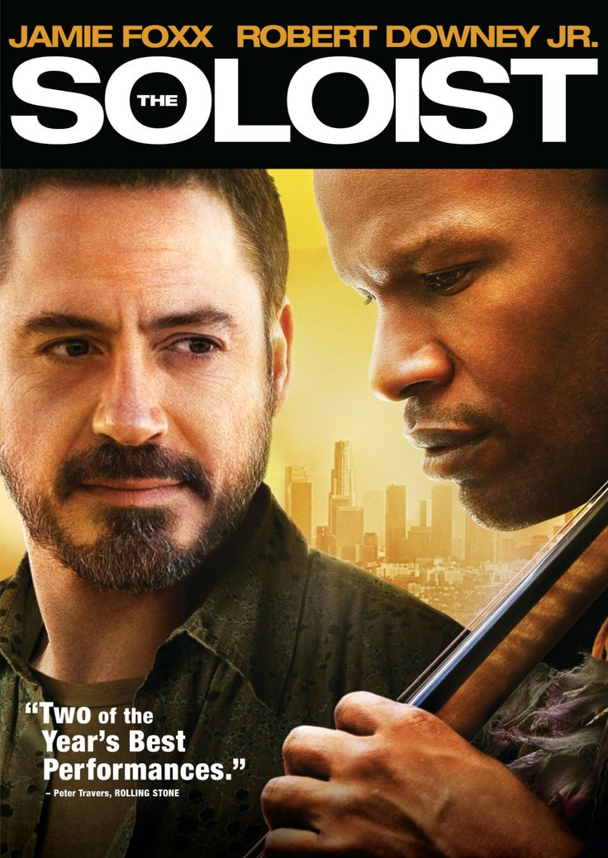
The soloist
Starring: | Robert Downey Jr., Jamie Foxx
What’s it about? | True story of a talented musician who struggles with schizophrenia
What topics is it useful for? | Schizophrenia
Age rating: | 15
Realism rating: | ****
Rating: | ****

Slide 17
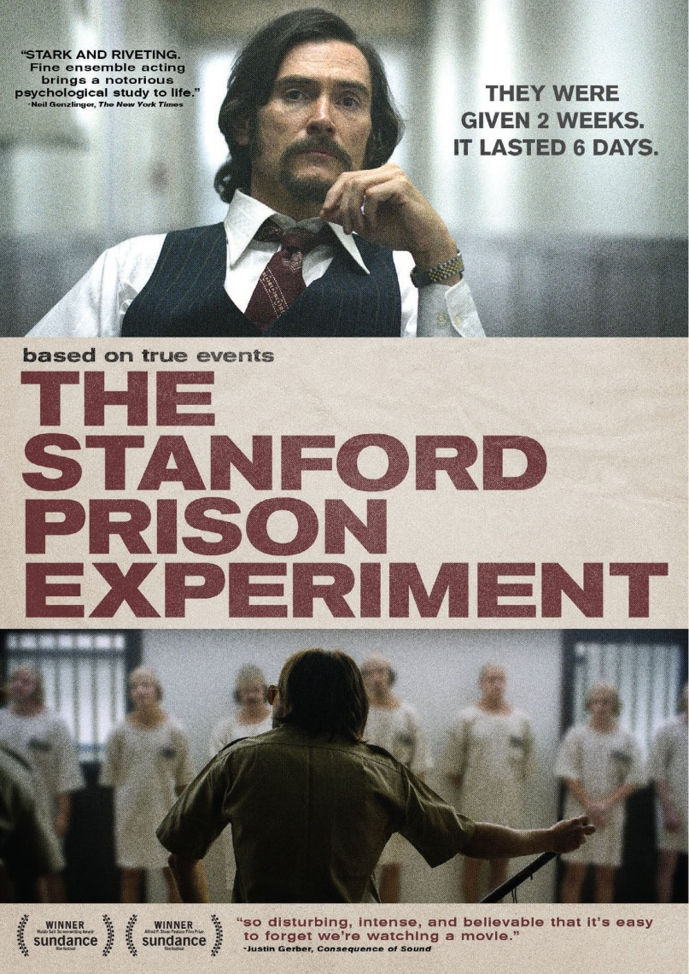
The Stanford prison experiment
Starring: | Billy Crudup
What’s it about? | The original SPE
What topics is it useful for? | Research Methods
Age rating: | 15
Realism rating: | ****
Rating: | ****

Slide 18
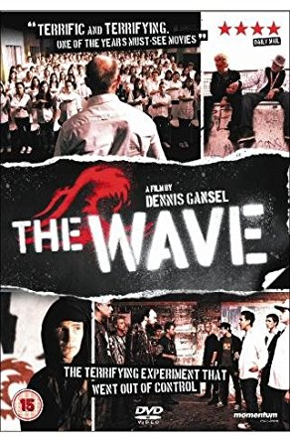
The Wave (Die Walle)
Starring: | Jurgen Vogel
What’s it about? | Based on a true story. A teacher sets up a demonstration with his class to show them how Hitler rose to power
What topics is it useful for? | Social Influence
Age rating: | 15
Realism rating: | ***
Rating: | ****

Slide 19
Psychology reading list

Slide 20
Bad Pharma
Author: | Ben Goldacre
What’s it about? | How pharmaceutical companies employ sneaky techniques to make their drugs look better than they are
What topics is it useful for? | Research Methods, Schizophrenia
Difficulty level: | *****
Rating: | *****

Slide 21
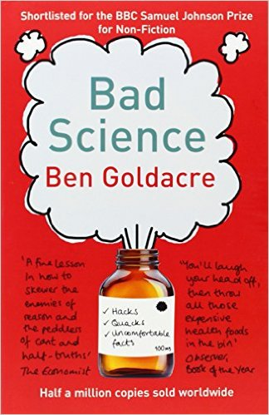
Bad Science
Author: | Ben Goldacre
What’s it about? | How to do research properly
What topics is it useful for? | Research Methods, Schizophrenia
Difficulty level: | *****
Rating: | *****

Slide 22
Behind the shock machine
Author: | Gina Perry
What’s it about? | The real story behind the Milgram obedience research
What topics is it useful for? | Research Methods, Issues and debates
Difficulty level: | **
Rating: | *****

Slide 23
Blink
Author: | Malcolm Gladwell
What’s it about? | The psychology of success
What topics is it useful for? | Research Methods
Difficulty level: | ***
Rating: | ***

Slide 24
Bounce
Author: | Matthew Syed
What’s it about? | The psychology of success in sport
What topics is it useful for? | Research Methods
Difficulty level: | ***
Rating: | ***

Slide 25
Forever Today
Author: | Deborah Wearing
What’s it about? | True story of a famous amnesiac patient
What topics is it useful for? | Biological and cognitive approach
Difficulty level: | **
Rating: | ****

Slide 26
Great myths of the brain
Author: | Christian Jarrett
What’s it about? | The myths surrounding the world’s most complex computer
What topics is it useful for? | Cognitive approach, Research Methods
Difficulty level: | ***
Rating: | ***

Slide 27
I think you’ll find it’s a bit more complicated than that
Author: | Ben Goldacre
What’s it about? | A collection of articles about how research should be done correctly
What topics is it useful for? | Research Methods, Schizophrenia
Difficulty level: | ****
Rating: | ****

Slide 28
Man (Dis)connected
Author: | Philip Zimbardo
What’s it about? | Why men are failing in modern society
What topics is it useful for? | Research Methods
Difficulty level: | ***
Rating: | **

Slide 29
Night School
Author: | Richard Wiseman
What’s it about? | Sleep
What topics is it useful for? | The biological approach
Difficulty level: | ***
Rating: | *****

Slide 30
Obedience to authority
Author: | Stanley Milgram
What’s it about? | Milgram’s famous shock experiments
What topics is it useful for? | Research Methods, Issues and debates
Difficulty level: | *****
Rating: | **

Slide 31
Opening Skinner’s box
Author: | Lauren Slater
What’s it about? | A collection of short summaries of famous psychology studies
What topics is it useful for? | The behaviourist approach, the biological approach, Research Methods
Difficulty level: | ***
Rating: | *****

Slide 32
Paranormality
Author: | Richard Wiseman
What’s it about? | The psychology behind ghosts, ghouls and the paranormal
What topics is it useful for? | Research Methods
Difficulty level: | **
Rating: | ***

Slide 33
Patient H.M.
Author: | Luke Dittrich
What’s it about? | The most famous case study in psychology, H.M.
What topics is it useful for? | The biological approach, Issues and debates
Difficulty level: | ***
Rating: | *****

Slide 34
Pioneers of Psychology
Author: | Raymond Fancher
What’s it about? | The history of psychology
What topics is it useful for? | Approaches in psychology, Issues and Debates
Difficulty level: | *****
Rating: | ****

Slide 35
Quirkology
Author: | Richard Wiseman
What’s it about? | A collection of weird and wonderful psychology studies
What topics is it useful for? | Memory, approaches, Research Methods
Difficulty level: | **
Rating: | ****

Slide 36
Shrinks
Author: | Jeffrey A. Lieberman
What’s it about? | The history of mental health treatment
What topics is it useful for? | Schizophrenia, Approaches
Difficulty level: | ****
Rating: | ****

Slide 37
Tell me I’m here
Author: | Anne Deveson
What’s it about? | True story of a mother whose son has schizophrenia
What topics is it useful for? | Schizophrenia
Difficulty level: | **
Rating: | ****

Slide 38
The bigamist
Author: | Mary Turner Thompson
What’s it about? | A true story of a woman’s life with a psychopath
What topics is it useful for? | Approaches in psychology
Difficulty level: | *
Rating: | ****

Slide 39
The brain that changes itself
Author: | Norman Doidge
What’s it about? | How our brains are plastic and can physically change throughout or lives
What topics is it useful for? | Research Methods, Biological approach
Difficulty level: | ****
Rating: | *****

Slide 40
The brain: the story of you
Author: | David Eagleman
What’s it about? | How the brain influences our behaviour
What topics is it useful for? | The biological approach, Schizophrenia
Difficulty level: | ****
Rating: | *****

Slide 41
The centre cannot hold
Author: | Elyn R. Saks
What’s it about? | An autobiography of someone who has survived schizophrenia
What topics is it useful for? | Schizophrenia, Research Methods
Difficulty level: | **
Rating: | ***

Slide 42
The Lucifer Effect
Author: | Philip Zimbardo
What’s it about? | The Stanford Prison study
What topics is it useful for? | Research Methods
Difficulty level: | ****
Rating: | ***

Slide 43
The man who couldn’t stop
Author: | David Adam
What’s it about? | The history of OCD told from the perspective of someone with the disorder
What topics is it useful for? | Approaches in psychology
Difficulty level: | ***
Rating: | *****

Slide 44
The man who mistook his wife for a hat
Author: | Oliver Sacks
What’s it about? | Interesting case studies of brain-damaged patients
What topics is it useful for? | Approaches, Issues and debates
Difficulty level: | *****
Rating: | ***

Slide 45
The man who shocked the world
Author: | Thomas Blass
What’s it about? | A biography of Stanley Milgram
What topics is it useful for? | Approaches in psychology
Difficulty level: | ***
Rating: | ****

Slide 46
The memory illusion
Author: | Julia Shaw
What’s it about? | Problems with memory, particularly eyewitness testimony
What topics is it useful for? | Research Methods, debates
Difficulty level: | ***
Rating: | *****

Slide 47
The Psychopath Test
Author: | Jon Ronson
What’s it about? | A journalist’s investigation into what makes someone a psychopath
What topics is it useful for? | Research Methods, Issues and debates
Difficulty level: | ***
Rating: | *****

Slide 48
The skeleton cupboard
Author: | Tanya Byron
What’s it about? | A collection of stories from the early career of a clinical psychologist
What topics is it useful for? | Schizophrenia
Difficulty level: | **
Rating: | ****

Slide 49
The tell-tale brain
Author: | V.S. Ramachandran
What’s it about? | The way the brain perceives the world
What topics is it useful for? | The biological approach, Research Methods
Difficulty level: | *****
Rating: | ***

Slide 50
The trouble with testosterone
Author: | Robert Sapolski
What’s it about? | The effect of testosterone on human behaviour, namely aggression
What topics is it useful for? | Approaches in psychology
Difficulty level: | ****
Rating: | ***

Slide 51
Testing Treatments
Author: | Imogen Evans
What’s it about? | How to do research properly
What topics is it useful for? | Research Methods, Schizophrenia
Difficulty level: | *****
Rating: | ****

Slide 52
Trick or treatment?
Author: | Simon Singh and Edzard Ernst
What’s it about? | Bogus science and how to detect it
What topics is it useful for? | Research Methods, Schizophrenia
Difficulty level: | ****
Rating: | ****

