Slide 1
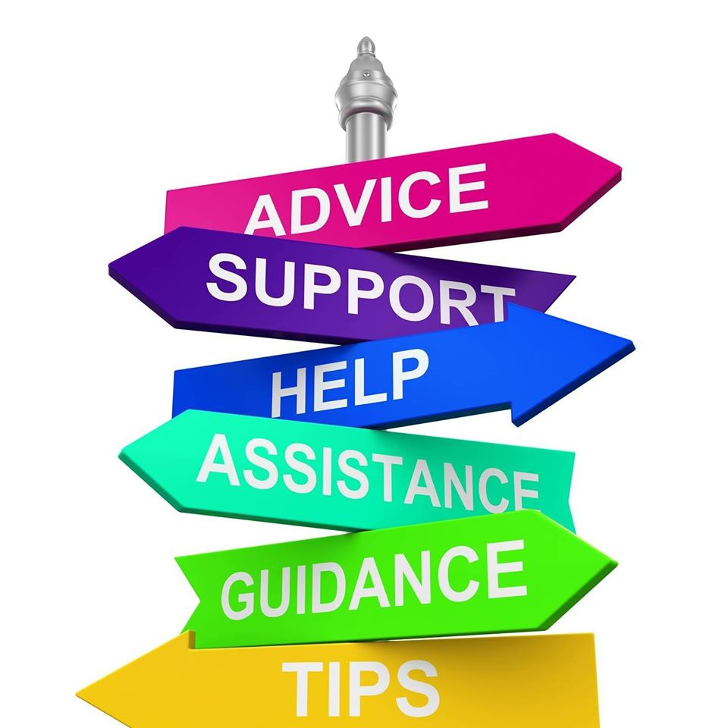
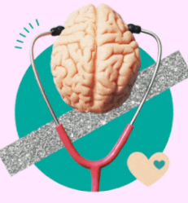
Maintaining your emotional wellbeing & how to access support

Slide 2
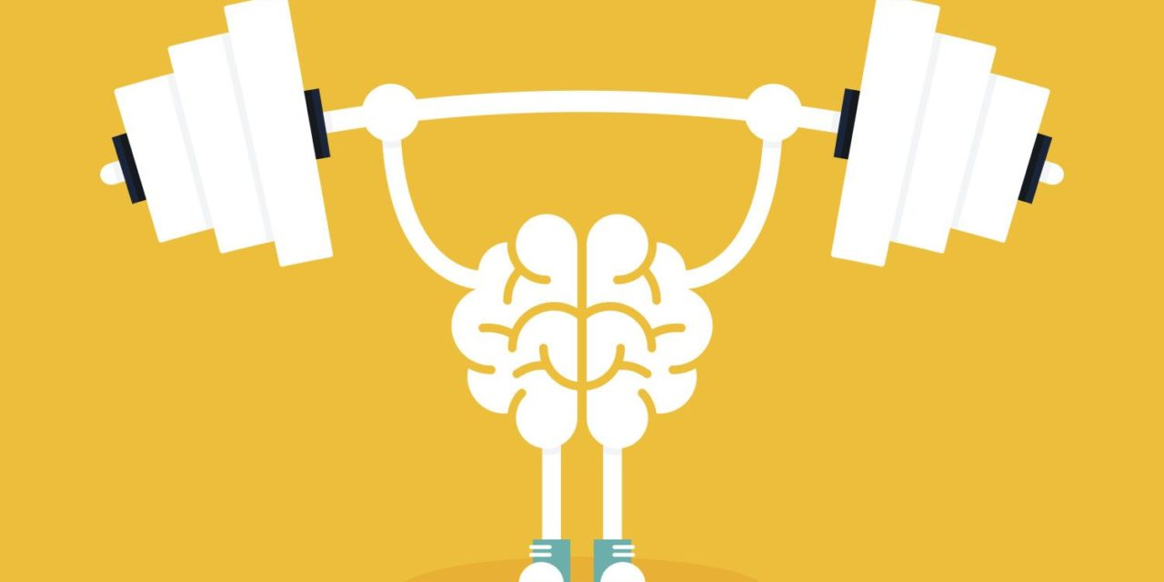
Improve your emotional wellbeing during the coronavirus pandemic and beyond
During this second lockdown, lots of young people have been struggling with being stuck inside again
Away from friends and family
Worried for their physical health
Worried for the health of their family and friends
If this is how you are feeling, one thing that may help during this pandemic is to practise positive psychology

Slide 3
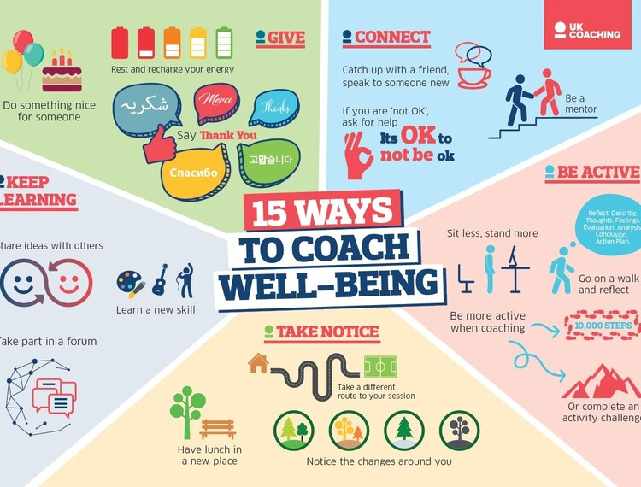

Slide 4
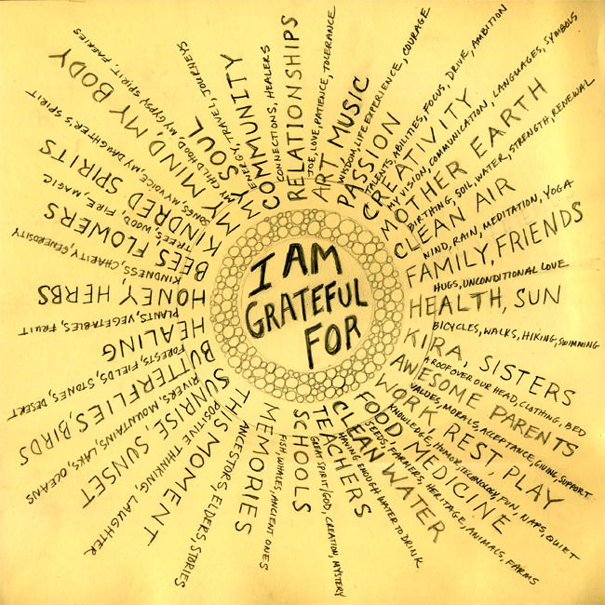
Gratitude & Perspective
Practising gratitude is not just a case of having a positive view of life, but a way of putting life into perspective
By thinking of what we are grateful for, it helps to shift our perspective from negative to positive
improved sleep
more enjoyment
more body satisfaction

Slide 5
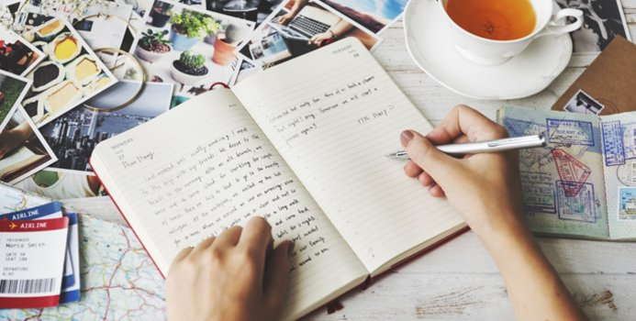
Gratitude diaries or Jar
A great way to incorporate gratitude into your daily routine
It is good to fill in your gratitude diary at night - end the day on a positive note and be relaxed before you sleep
Use a journal, notebook or jar
It’s also great to read on days when you might be feeling particularly down or anxious
You can read back through to help remind you what you have to be positive about

Slide 6
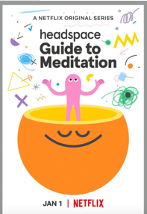
Mindfulness & Meditation
Mindfulness is another helpful way to use positive psychology in everyday life
the aim is to allow you to observe your thoughts, feelings, and emotions without criticism
reduced sensitivity to pain, depression, stress & anxiety
"Meditation" is actually a collection of mindfulness techniques that can help you cope with or find solutions for different problems in your life
The Headspace guide introduces viewers to eight different styles of meditation, one per episode
You can use apps like Headspace or Calm to learn how to practise mindfulness

Slide 7
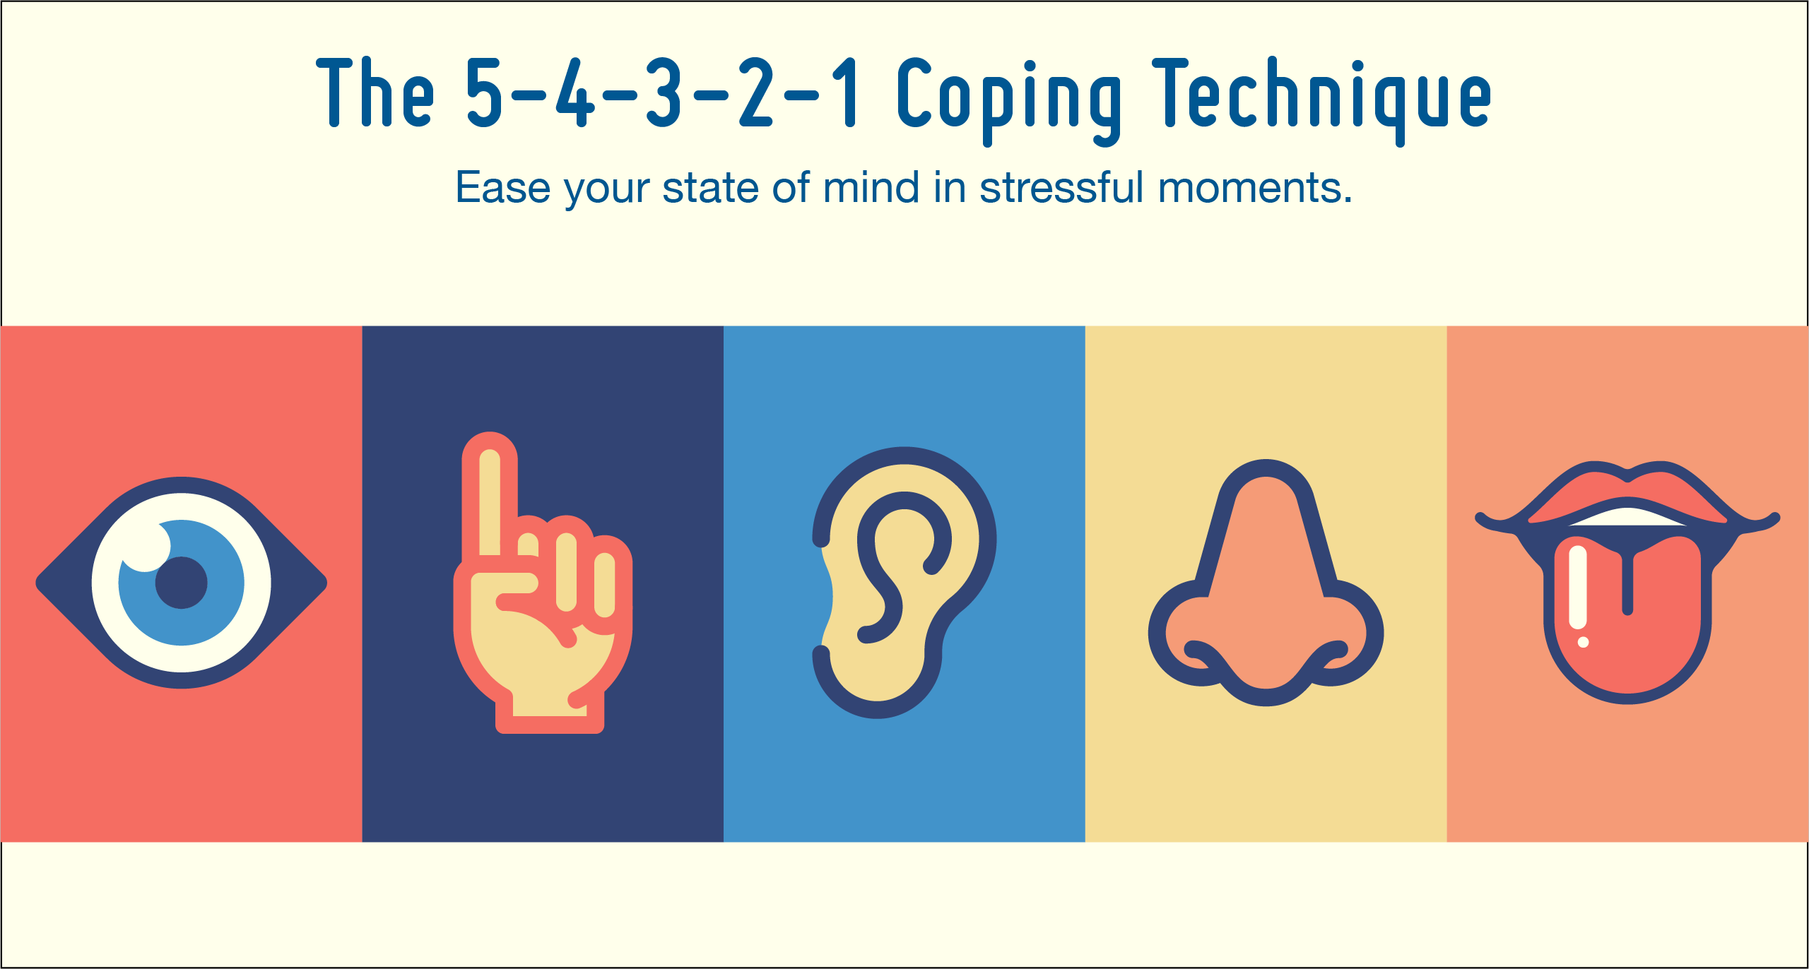
54321 Mindfulness technique
a great way to observe what is going on around you in the present moment, and useful to use if you are experiencing a moment of anxiety.
identify five things you can see
four things you can hear
three things you can feel
two things you can smell
one thing you can taste

Slide 8
Struggling or not feeling great?
If you are struggling or not feeling great, give some of these techniques and tips a try
Do not forget you are not alone in how you feel
The negative feelings will pass, and hopefully these techniques can help that happen
Remember you can talk to an adult that you trust about how you’re feeling or use helplines too
You can do this!!!

Slide 9
Useful links and services
Friends, teachers, Wellbeing department & Progress Leaders
https://youngminds.org.uk/ Support resources and other service information
https://www.childline.org.uk/ - If you’re under 19 you can confidentially call, chat online or email about any problem big or small
http://www.stepiau.org/covid-19 - The Primary Mental Health Support Service (PMHSS) is a service for people of all ages living with mental health difficulties such as stress, anxiety, or depression. The service covers all areas of Cardiff and the Vale of Glamorgan. It is provided by the NHS and is free of charge
https://www.barnardos.org.uk/what-we-do/services/vale-school-and-community-based-counselling-service/self-referral-form - Online Self-Referral Form Mob./Text: 07738689262 Tel: 02920 577074 Email: valecounsellingservice@barnardos.org.uk

